Slide 1
Introduction to Quarto with R
Madeline Gillman

Slide 2
What is Quarto?
An open source publishing system
Allows you to create cool dynamic content
Make reproducible documents/publications that are publication quality
articles, presentations, dashboards, websites, blogs, and books in HTML, PDF, MS Word, ePub…

Slide 3
Why Quarto?
A way to combine code + prose
Multiple languages
Reproducible, support many output formats
Easily create presentation-ready documents that can be easily updated and shared
Can be a lab analysis notebook
You don’t even need to know Markdown!

Slide 4
Creating an analysis notebook
The Quarto document can be used to run analyses—but I recommend keeping that in separate scripts.
A more realistic way for us to use Quarto in our lab: integrating data exploration, methods, and analysis choices to keep us organized and easily share with collaborators in multiple formats

Slide 5
Creating an analysis notebook
Open R Studio
File -> New File -> Quarto Document
Here, you’ll be prompted to enter some metadata. This metadata will go in the YAML header (more on that later)

Slide 6
Orienting yourself in Quarto

Slide 7
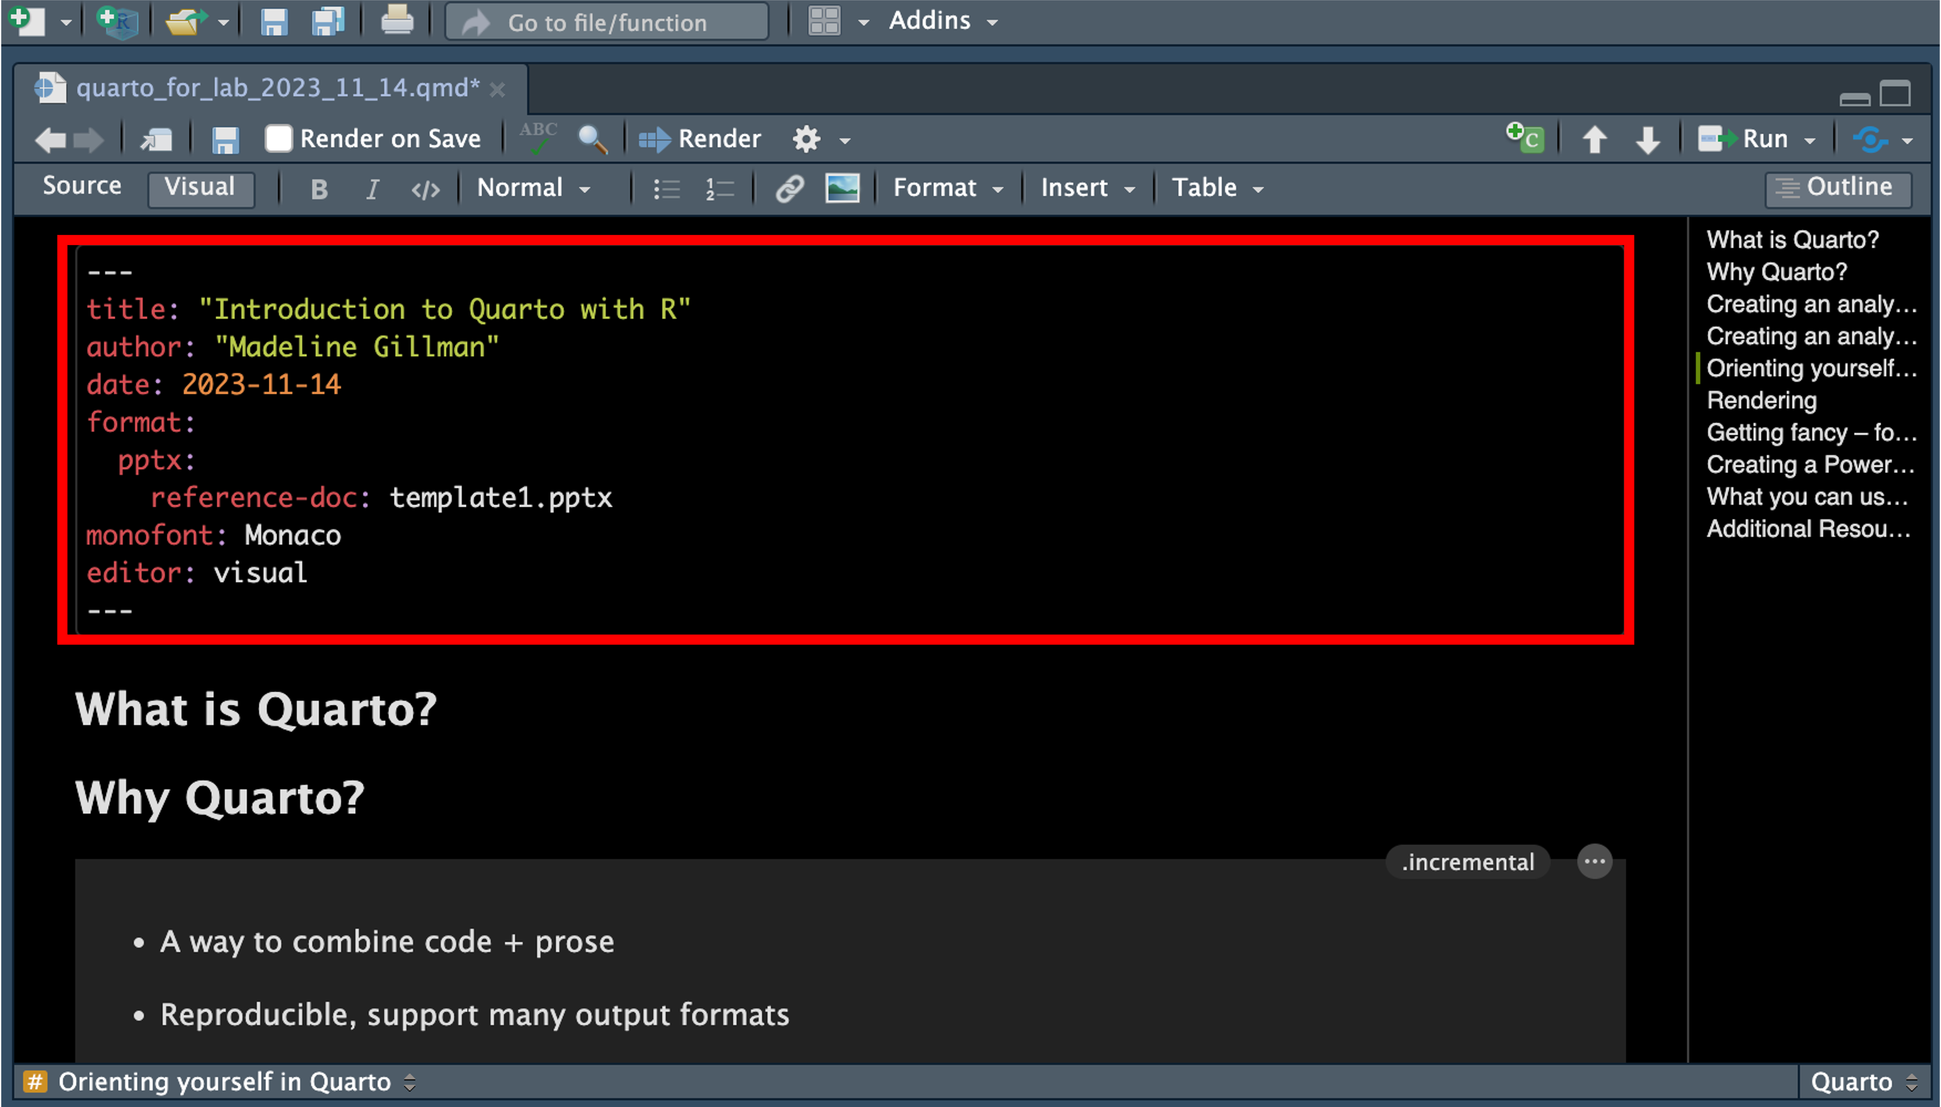
The YAML header

Slide 8
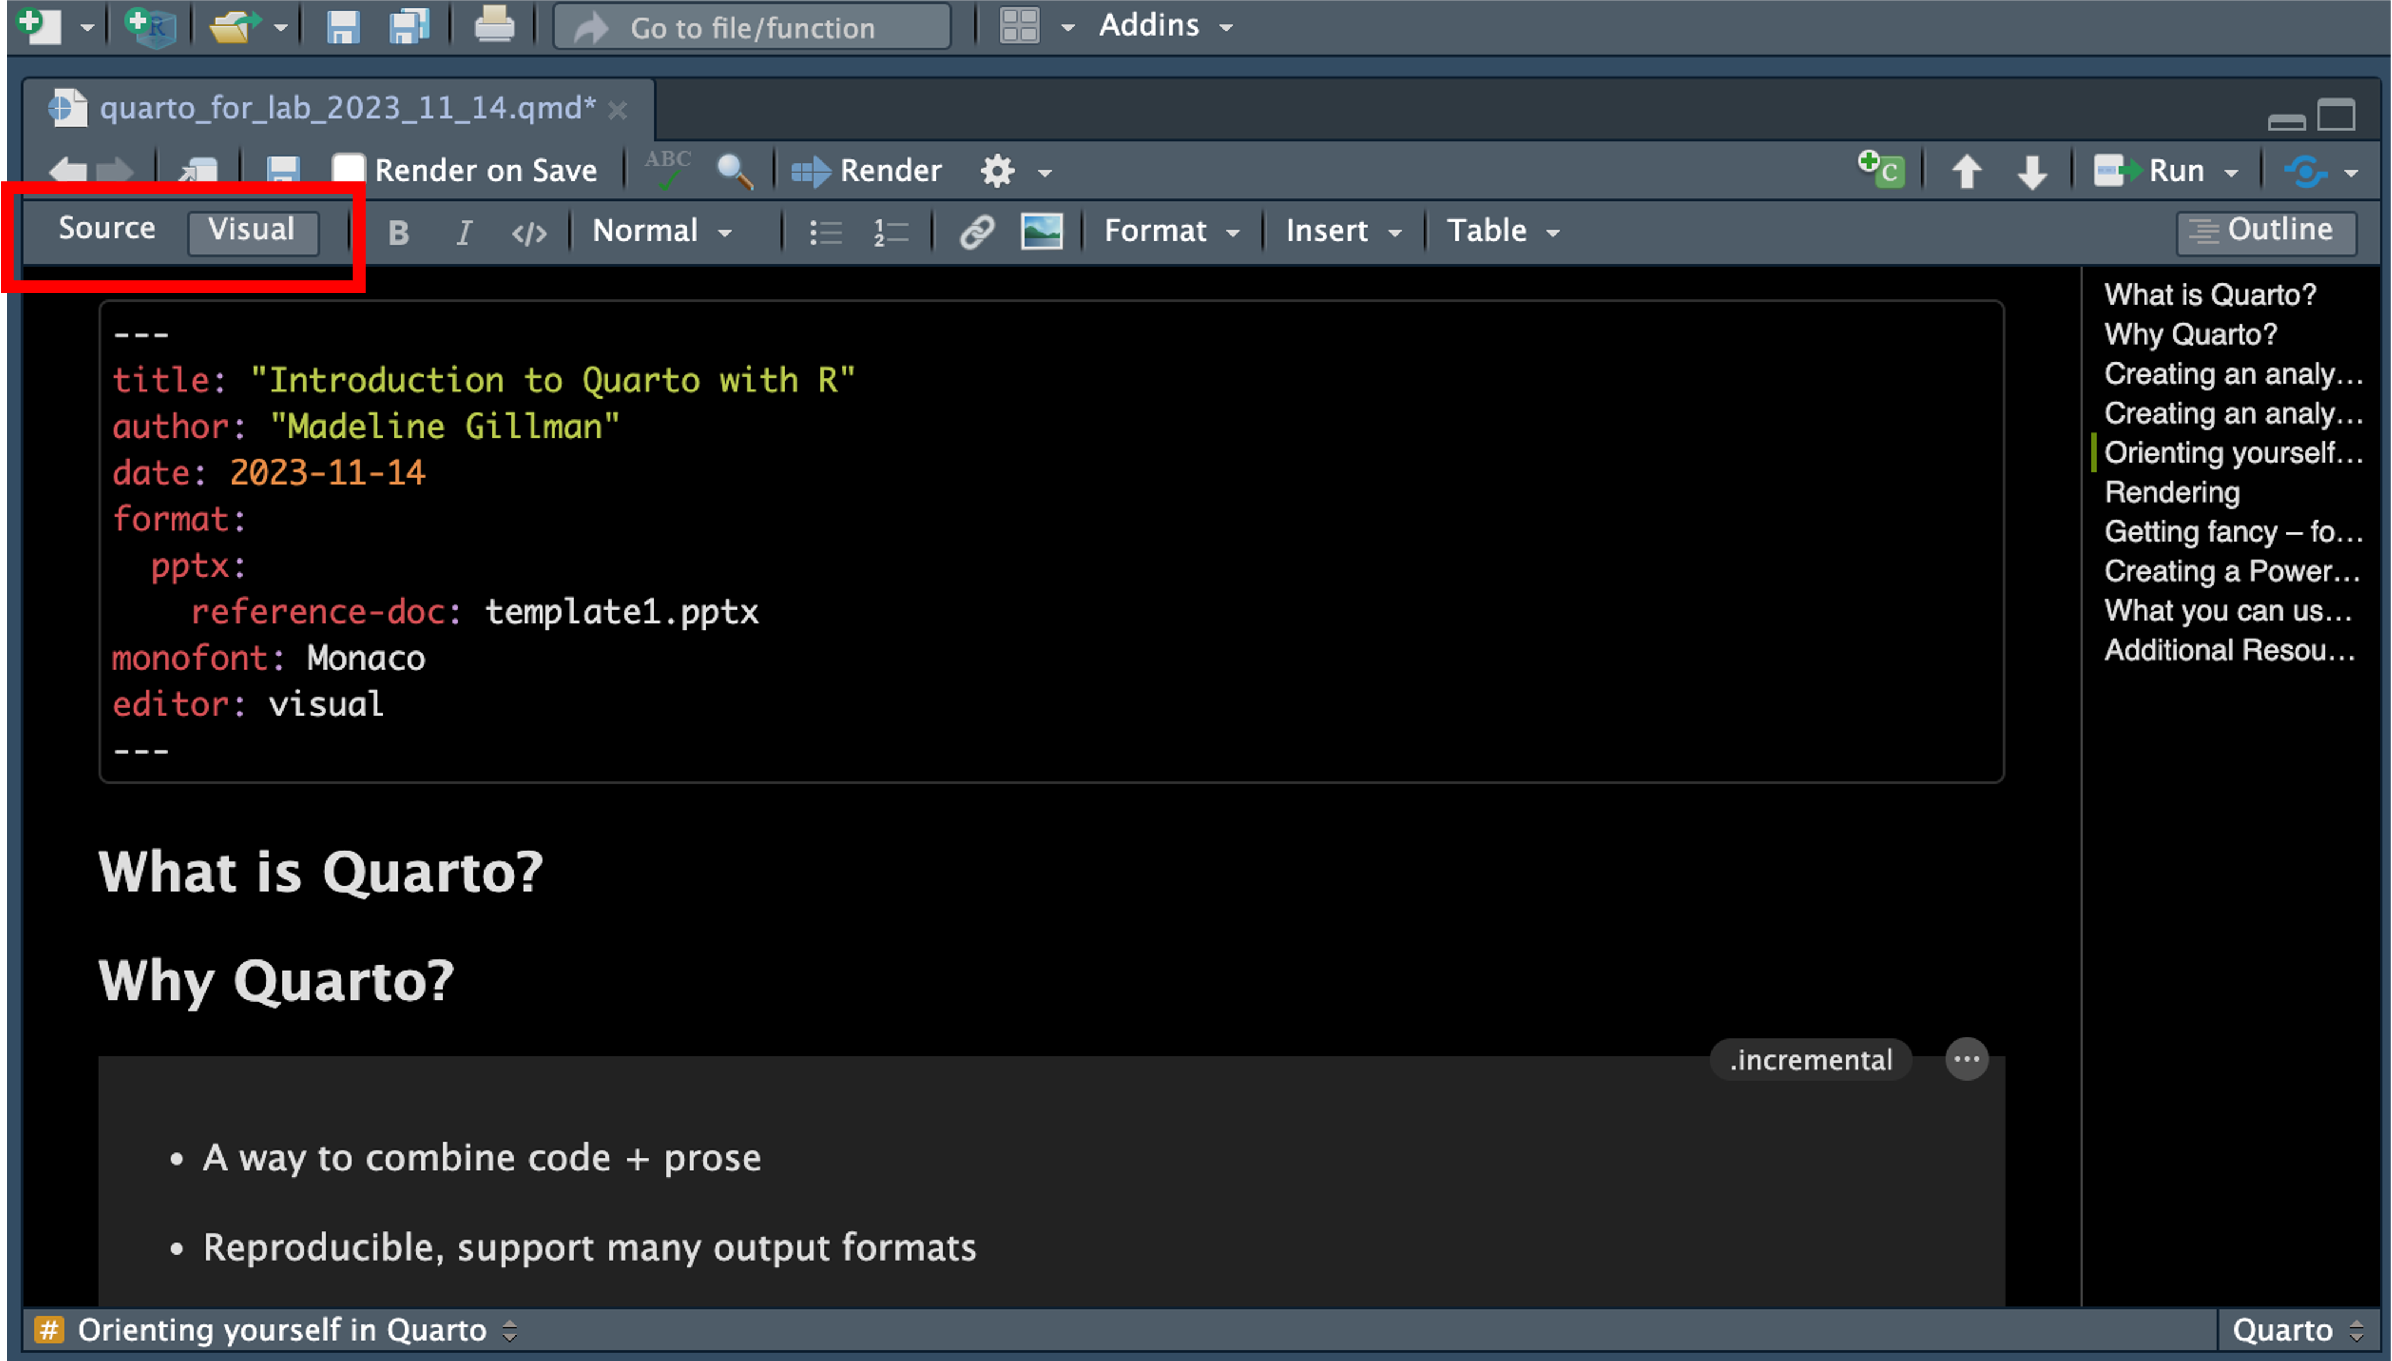
Source vs. visual editor

Slide 9
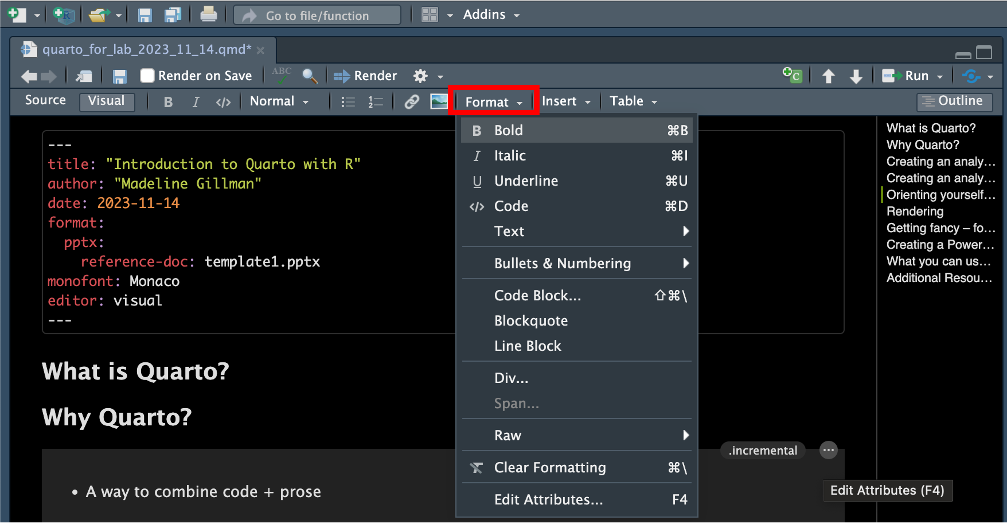
Formatting options

Slide 10
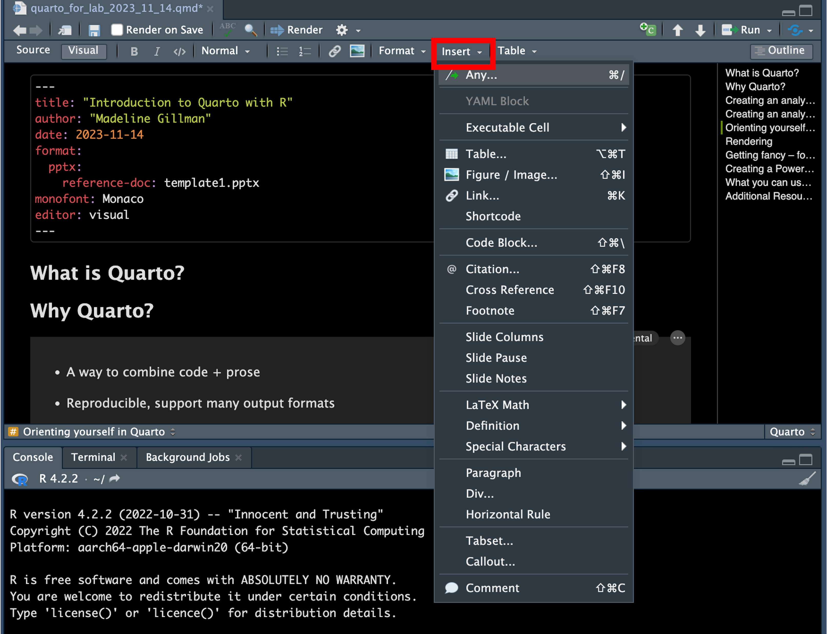
Adding code chunks, images, links, and more

Slide 11
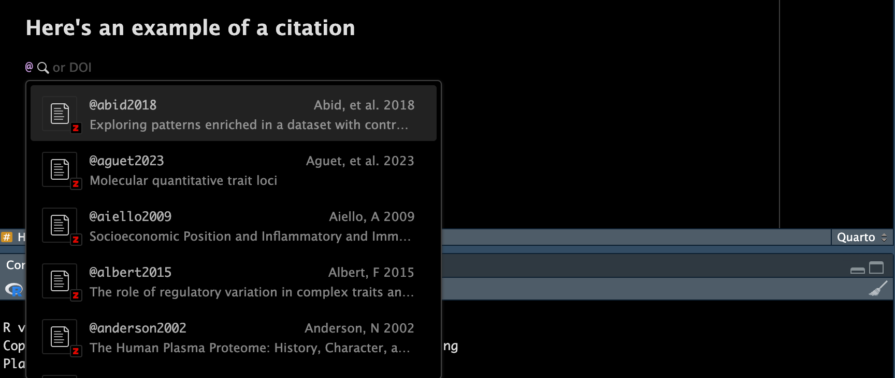
Adding citations

Slide 12
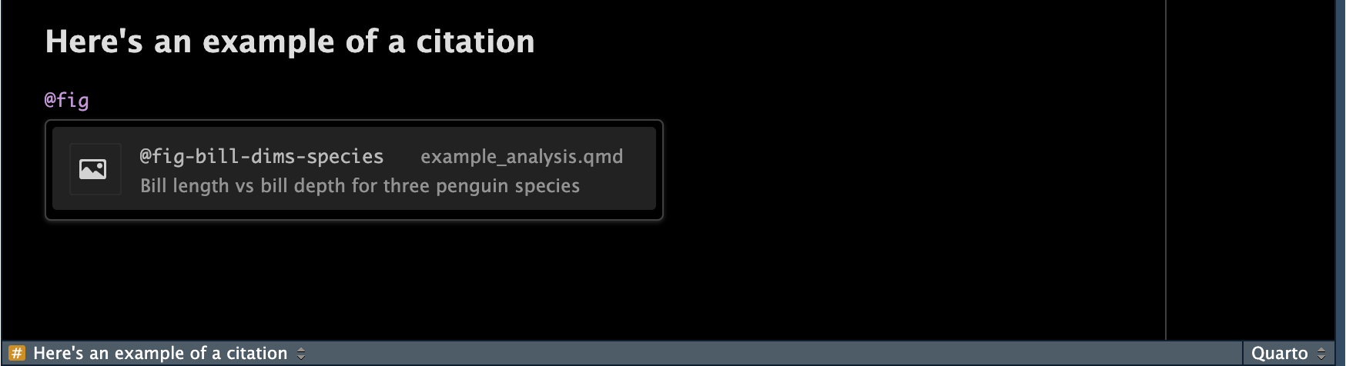
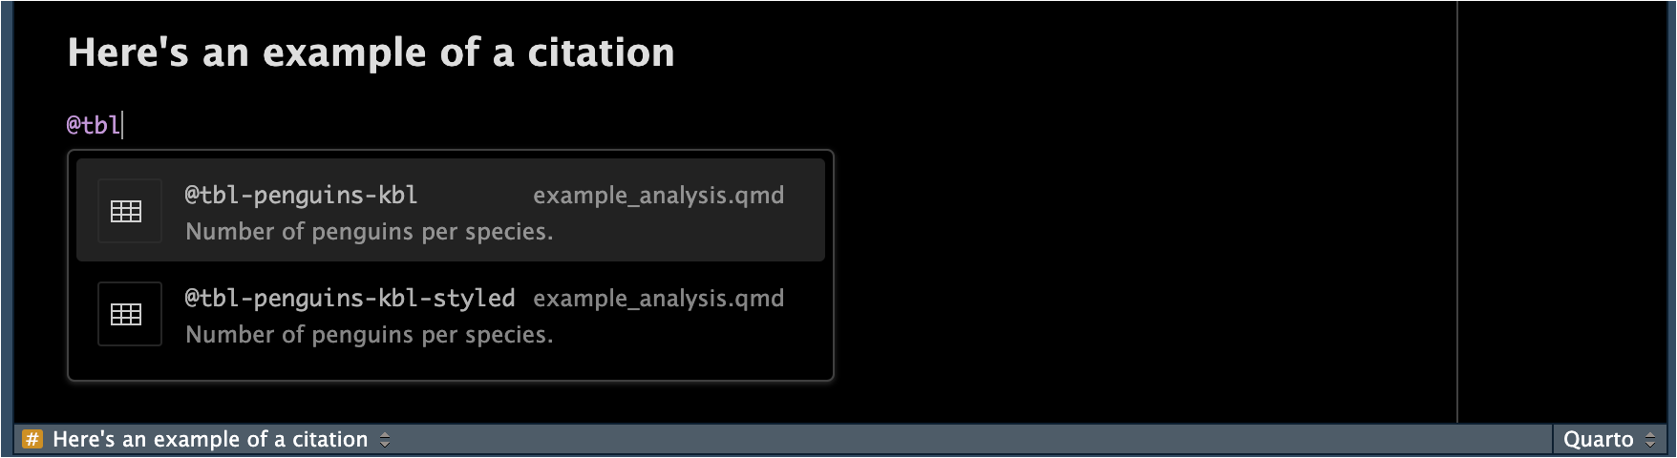
Adding table and figure references

Slide 13
Rendering
When you click the Render button a document will be generated that includes:
Content authored with markdown
Output from executable code
You may need to install a LaTeX distribution. You can install using R by running: tinytex::install_tinytex()

Slide 14
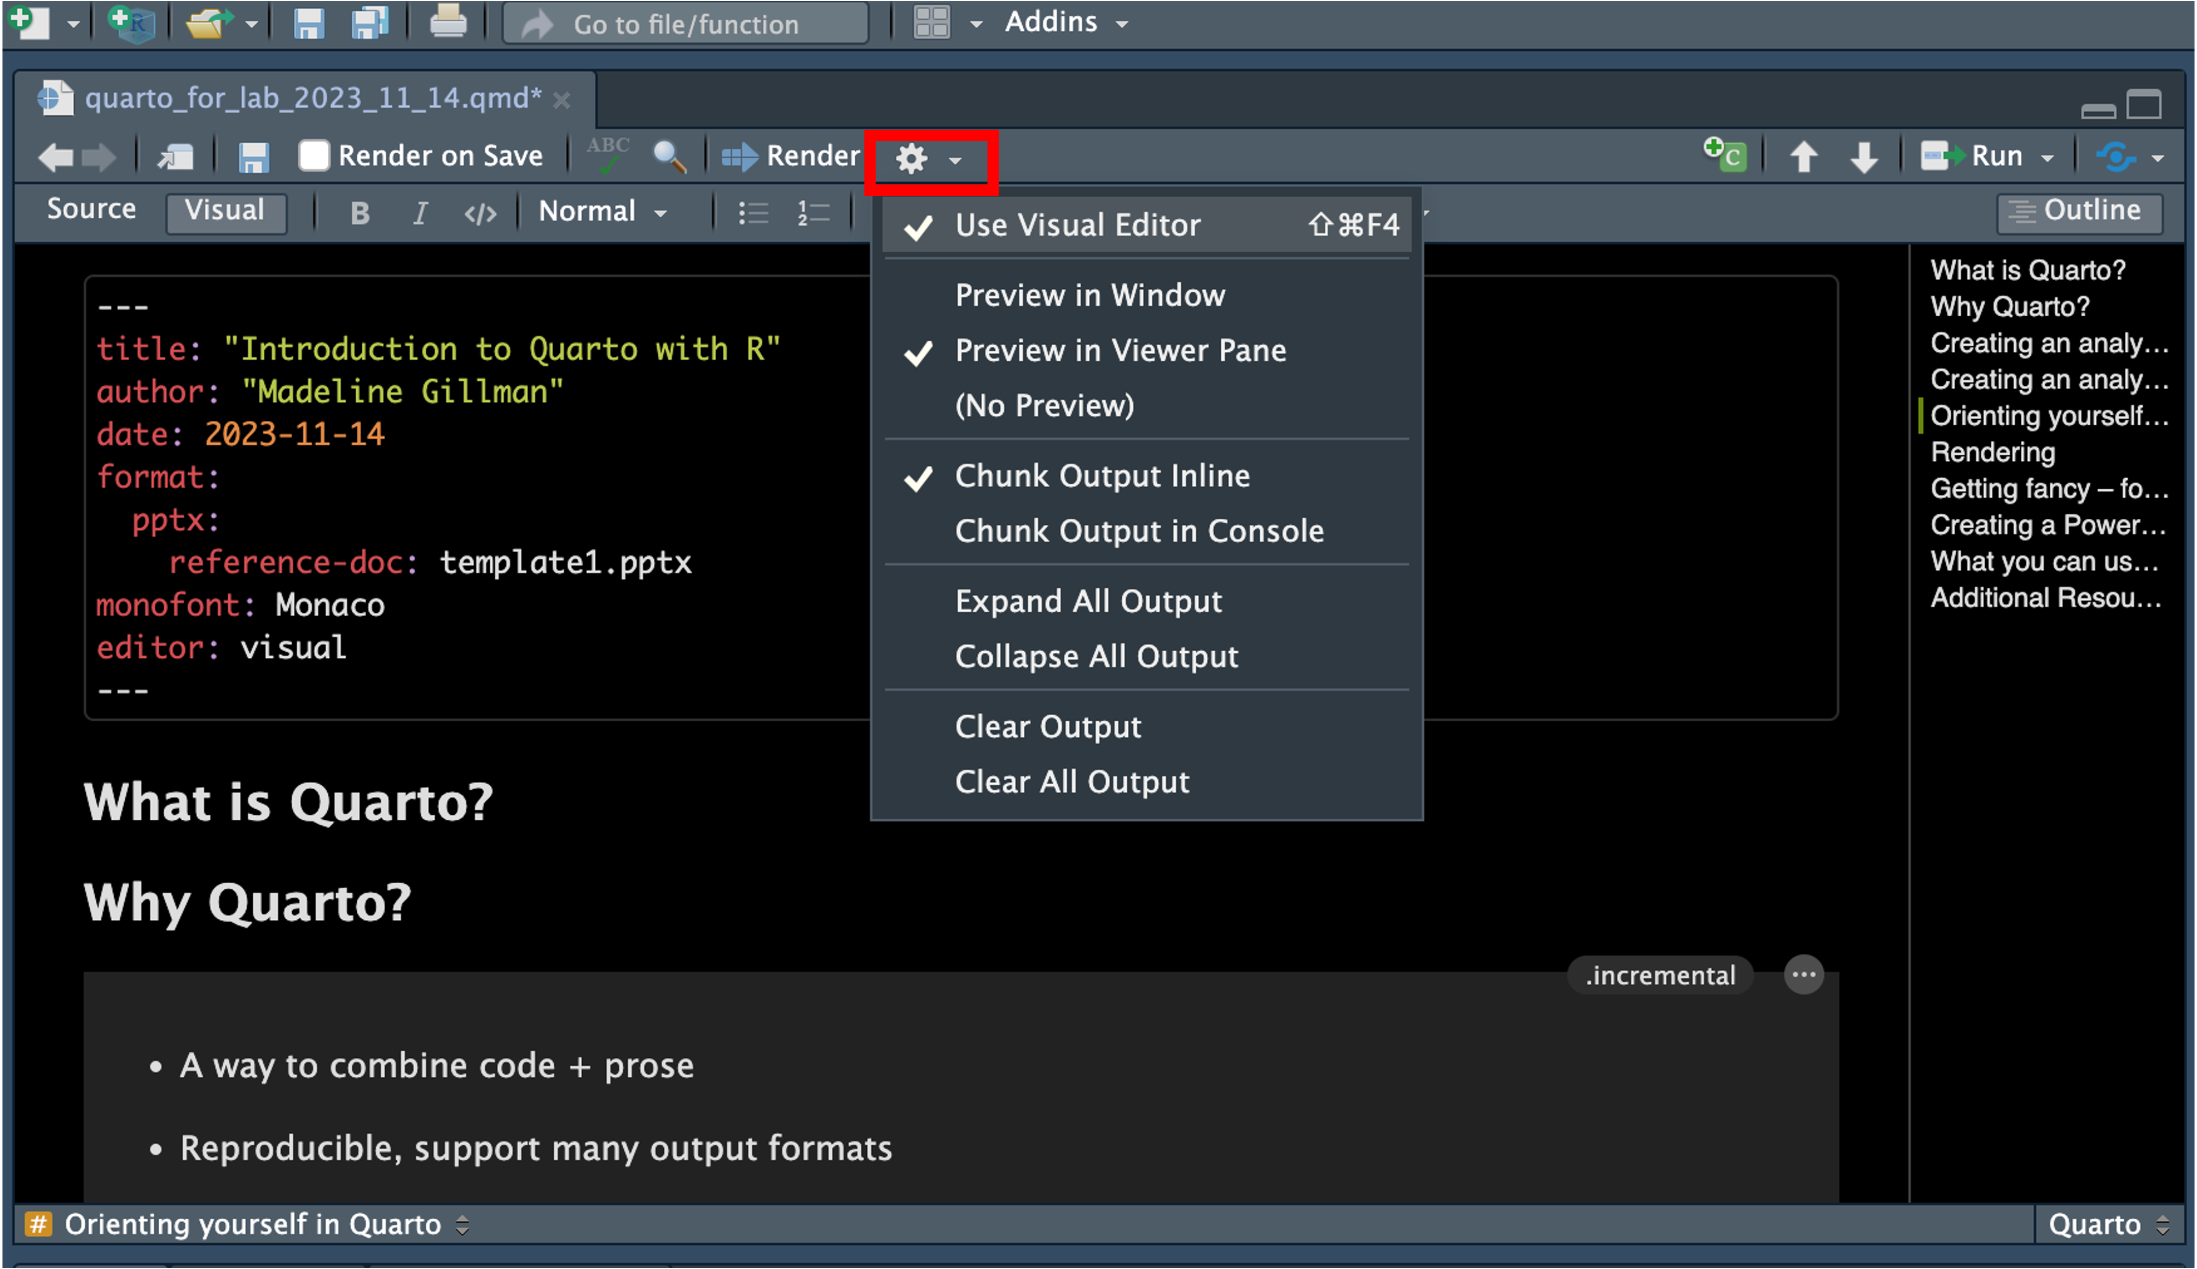
Render options

Slide 15
Getting fancy – fonts
First, check which fonts you have available:
# install.packages("systemfonts") fonts <- systemfonts::system_fonts() View(fonts)
Then, update your YAML with a font name under the name column:
mainfont: ArialMT
monofont: Monaco

Slide 16
What you can use Quarto for starting today!
Lab notebook
Read in results files and blend code, methods, analysis decisions, tables, plots, etc.
Export output as pdf, html, or word doc
Create presentations
Export output as html, pptx
Personal branding
Resume
Website
Writing papers (maybe)

Slide 17
Git and Github

Slide 18
What is git?
Git is a version control software
Track and manage changes to code/software in a safe way

Slide 19
Why use git?
Git is widely used across academia and knowing git is essential for any computational work in industry
Track changes (versions) of your code in an reproducible, open-source way
Make and test changes while maintaining a “master” version

Slide 20
What is Github?
A repository hosting service
Free to have public repositories, paid account required for several private repositories
You can get free GitHub Pro as a student
Another repository hosting service: Bitbucket

Slide 21
Getting started
Create a GitHub account
Sign up for GitHub Educationt to access more features
Link Longleaf with your GitHub account
See Connecting to GitHub with SSH
You’ll probably already have an existing SSH key
Clone or initiate your first repository!
git clone <SSH_key_from_repository>
mkdir <directory_name>
cd <directory_name>
git init
GitHub only allows letters, numbers, and the special characters “-”, “_”, and “.”
So: no spaces, no #$%^&*()@!

Slide 22
A quick aside on what to use GitHub for
GitHub is not Google Drive
If you try to add large files, you’ll run into issues
GitHub is not a secure place to store data
Especially for the kind of research we do, track scripts only
You should be able to recreate all intermediate data files, plots, results, etc. using your scripts anyways!
Probably best to keep most repositories private (unless the repository has code you are intending to share such as as part of an open source tool or paper)

Slide 23
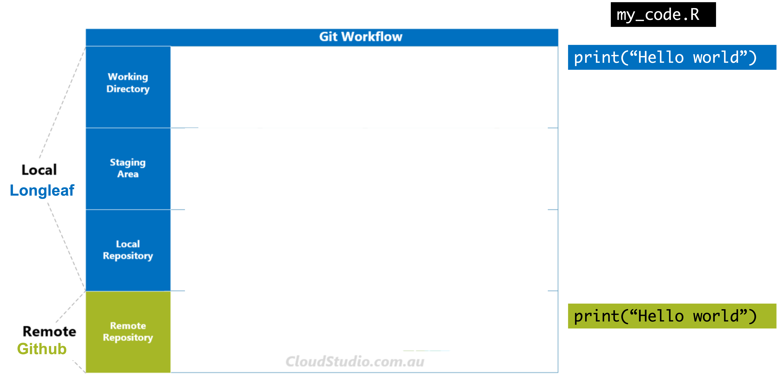
A basic git workflow

Slide 24
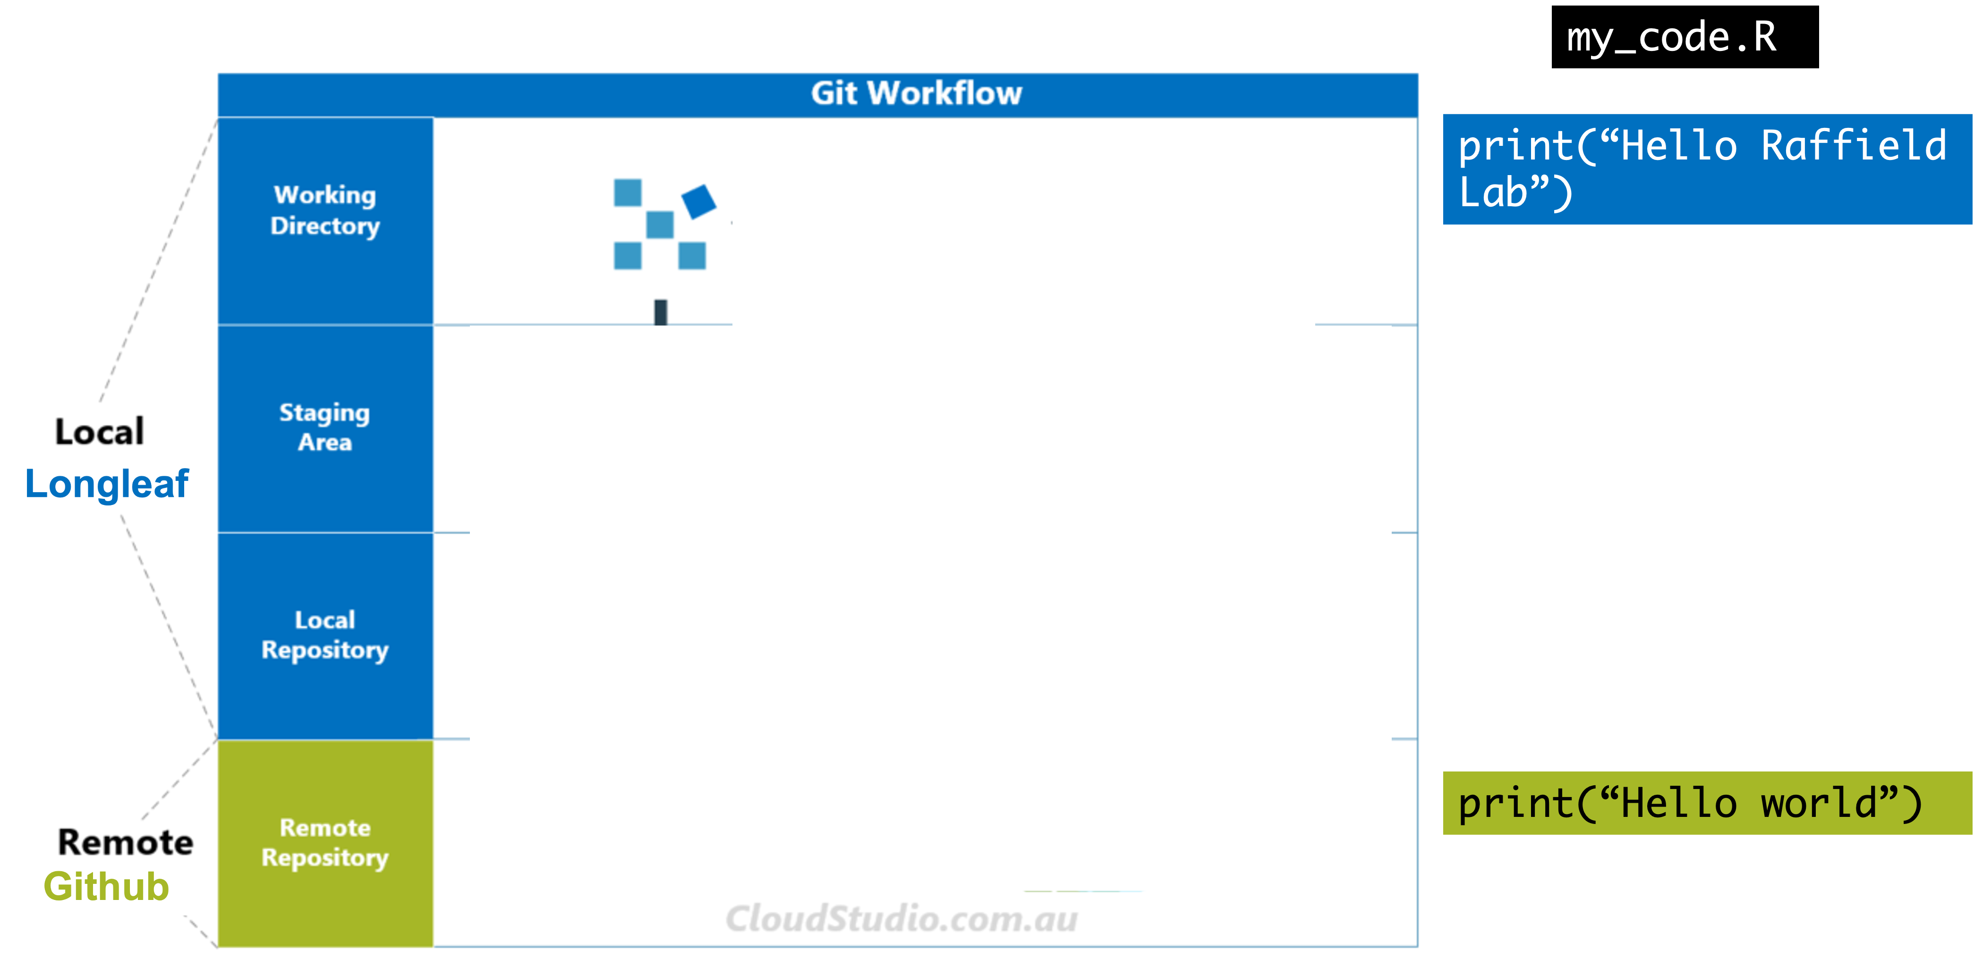
A basic git workflow - pushing a change

Slide 25
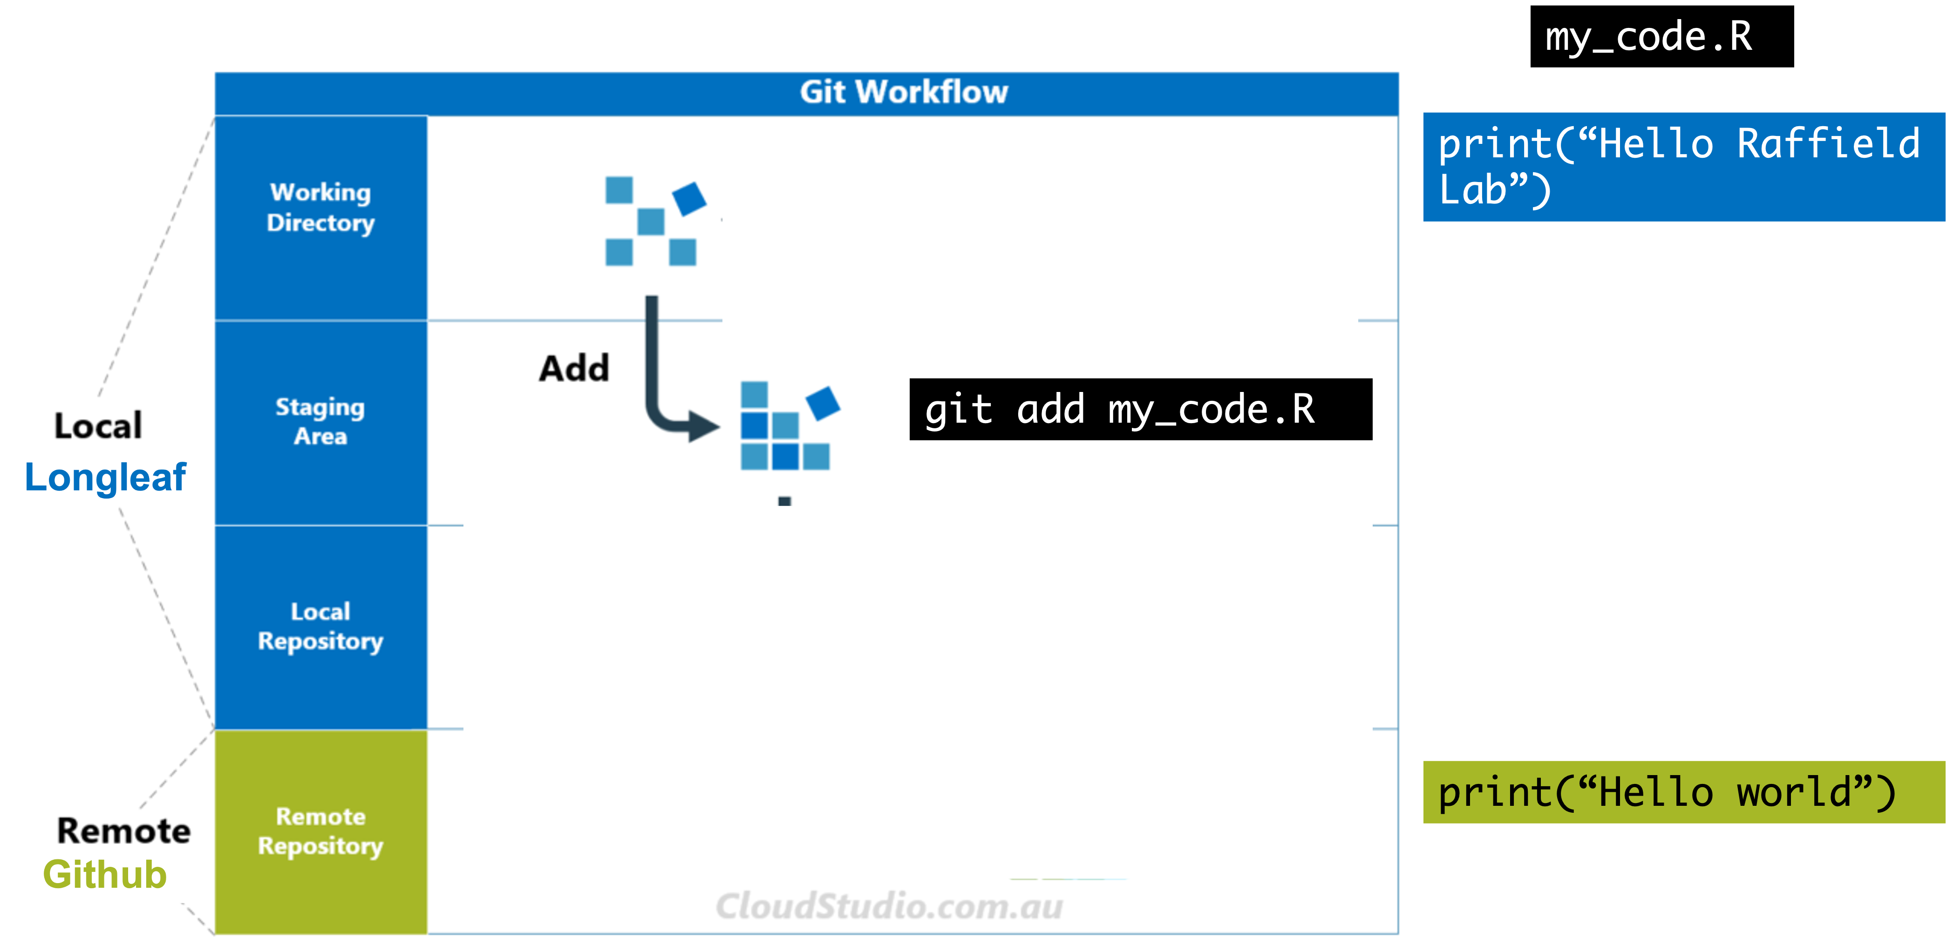
A basic git workflow - pushing a change

Slide 26
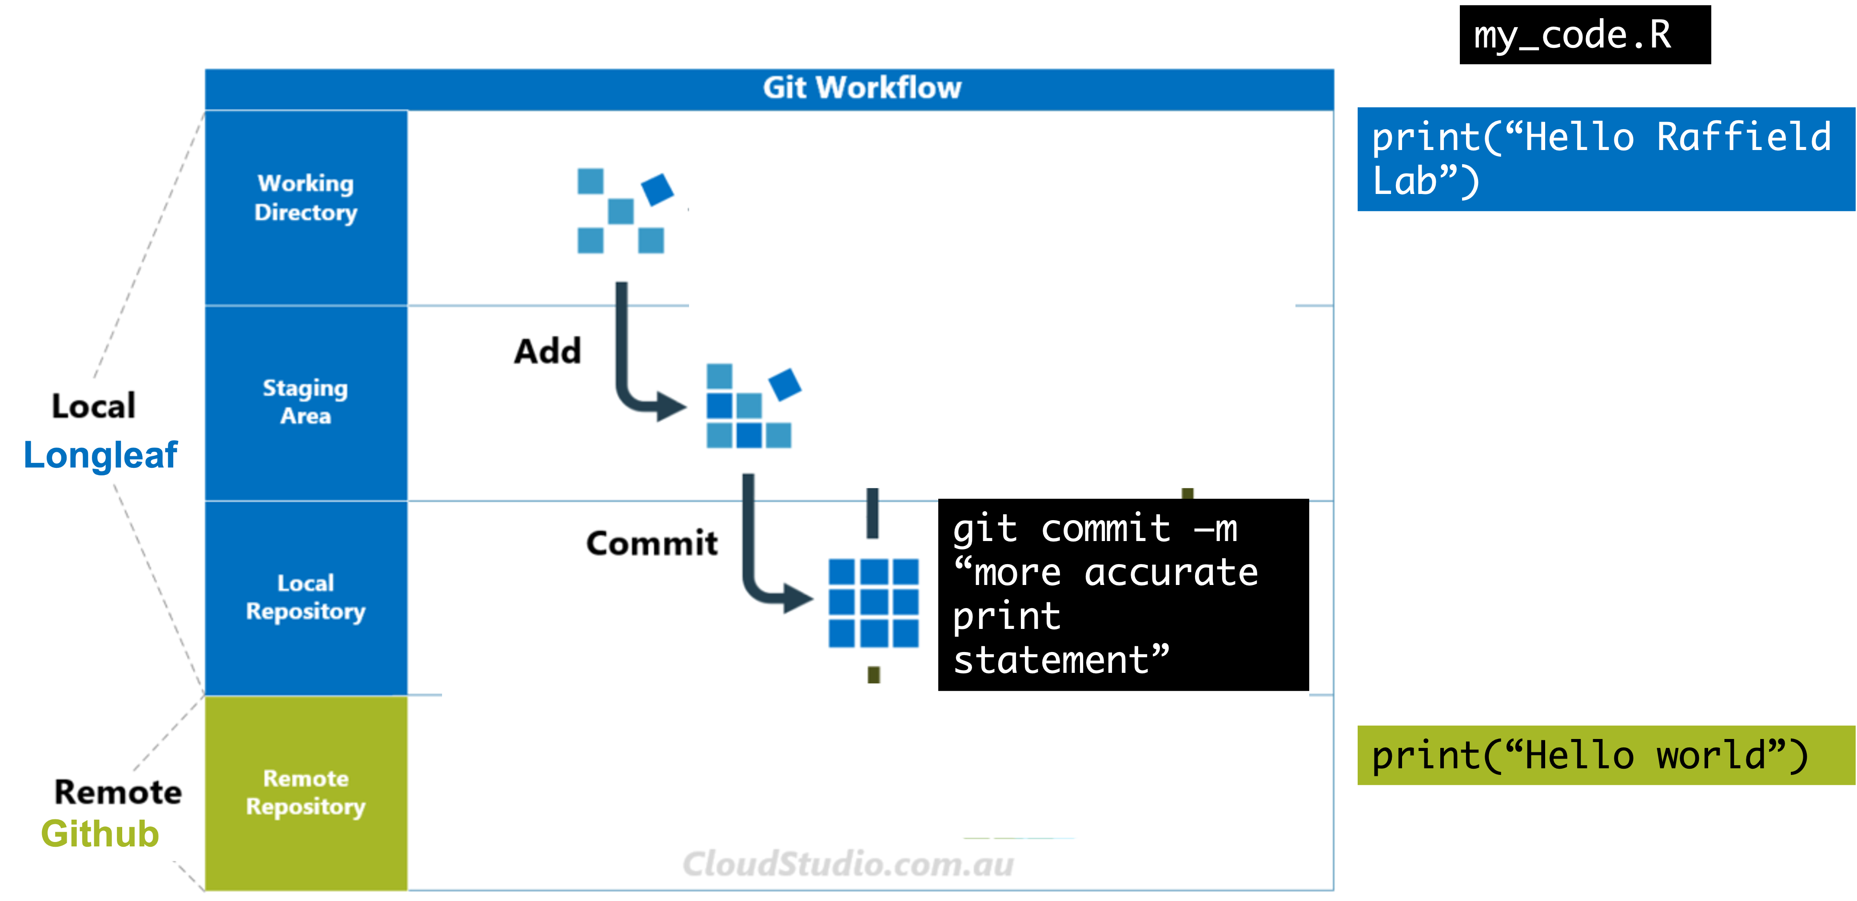
A basic git workflow - pushing a change

Slide 27
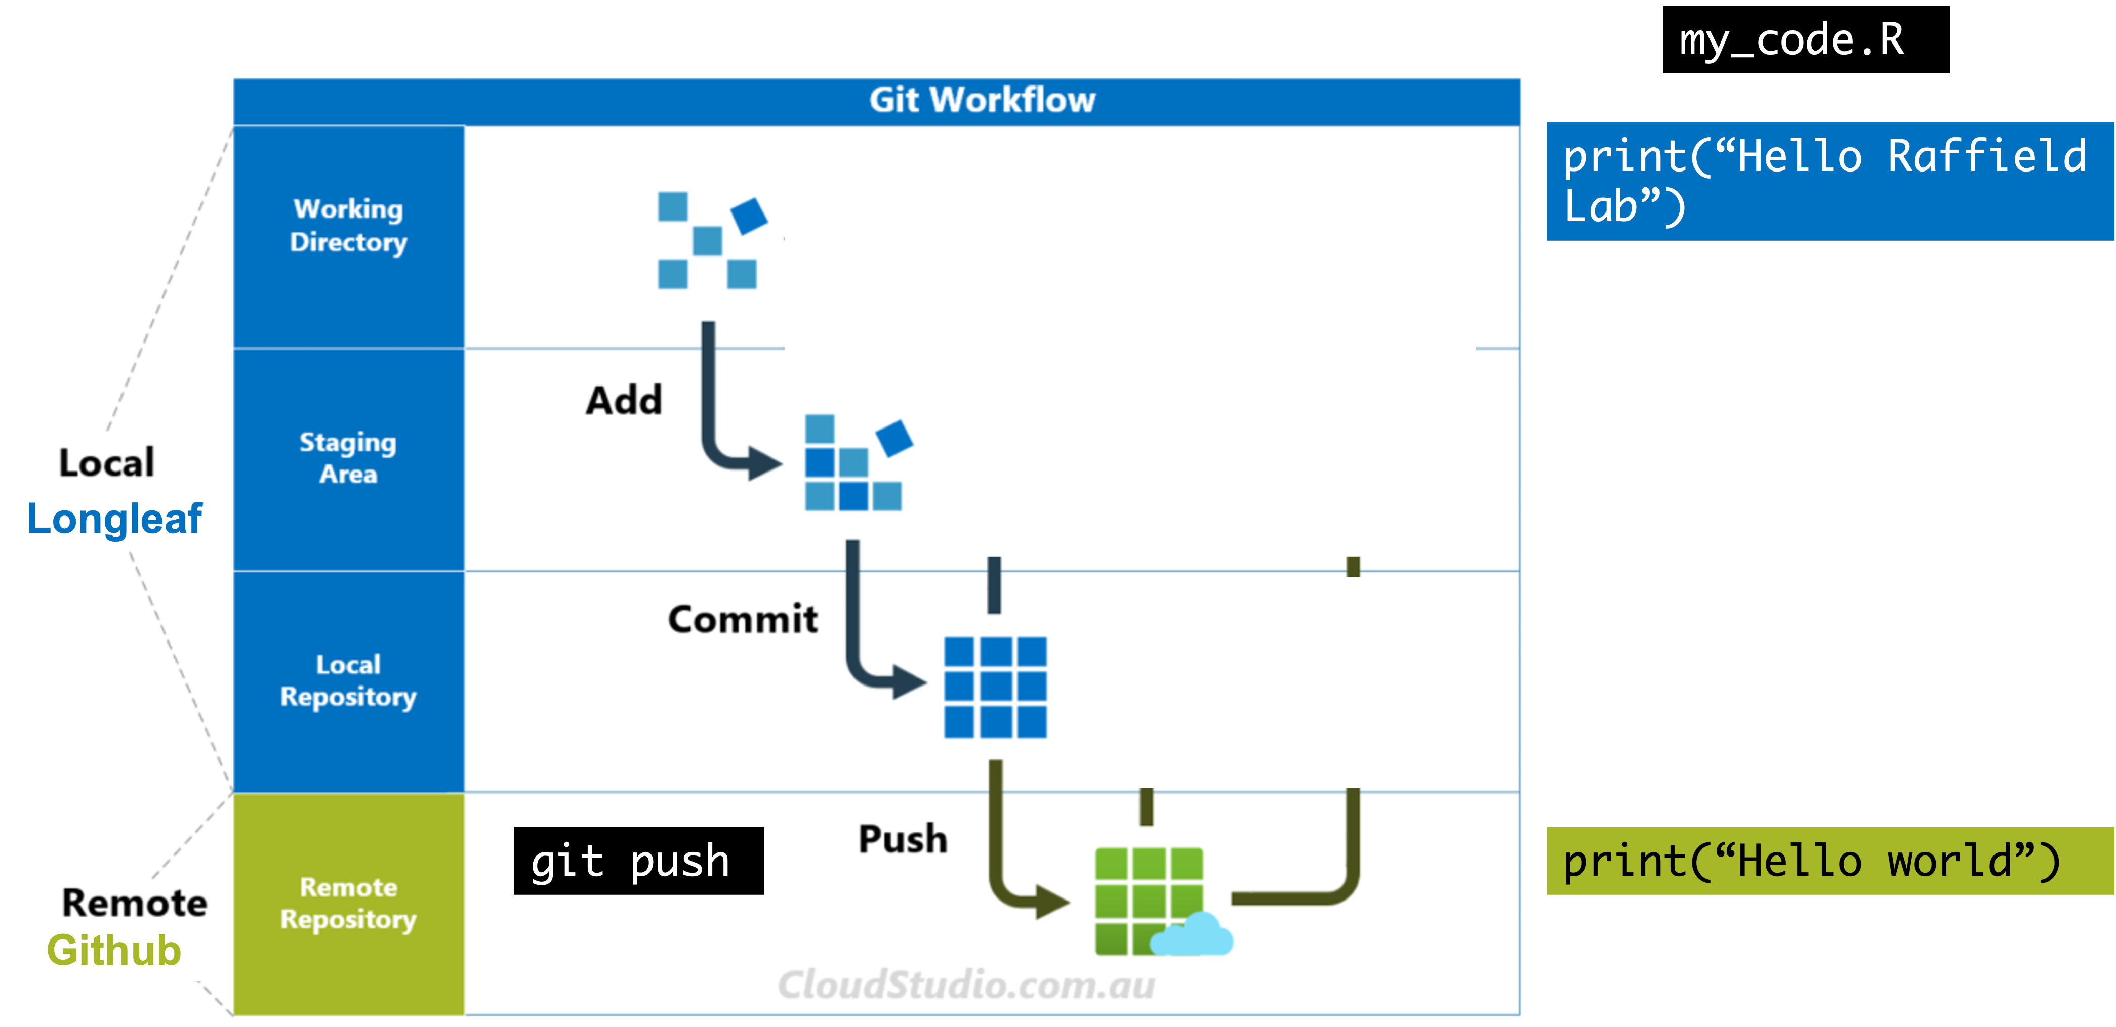
A basic git workflow - pushing a change

Slide 28
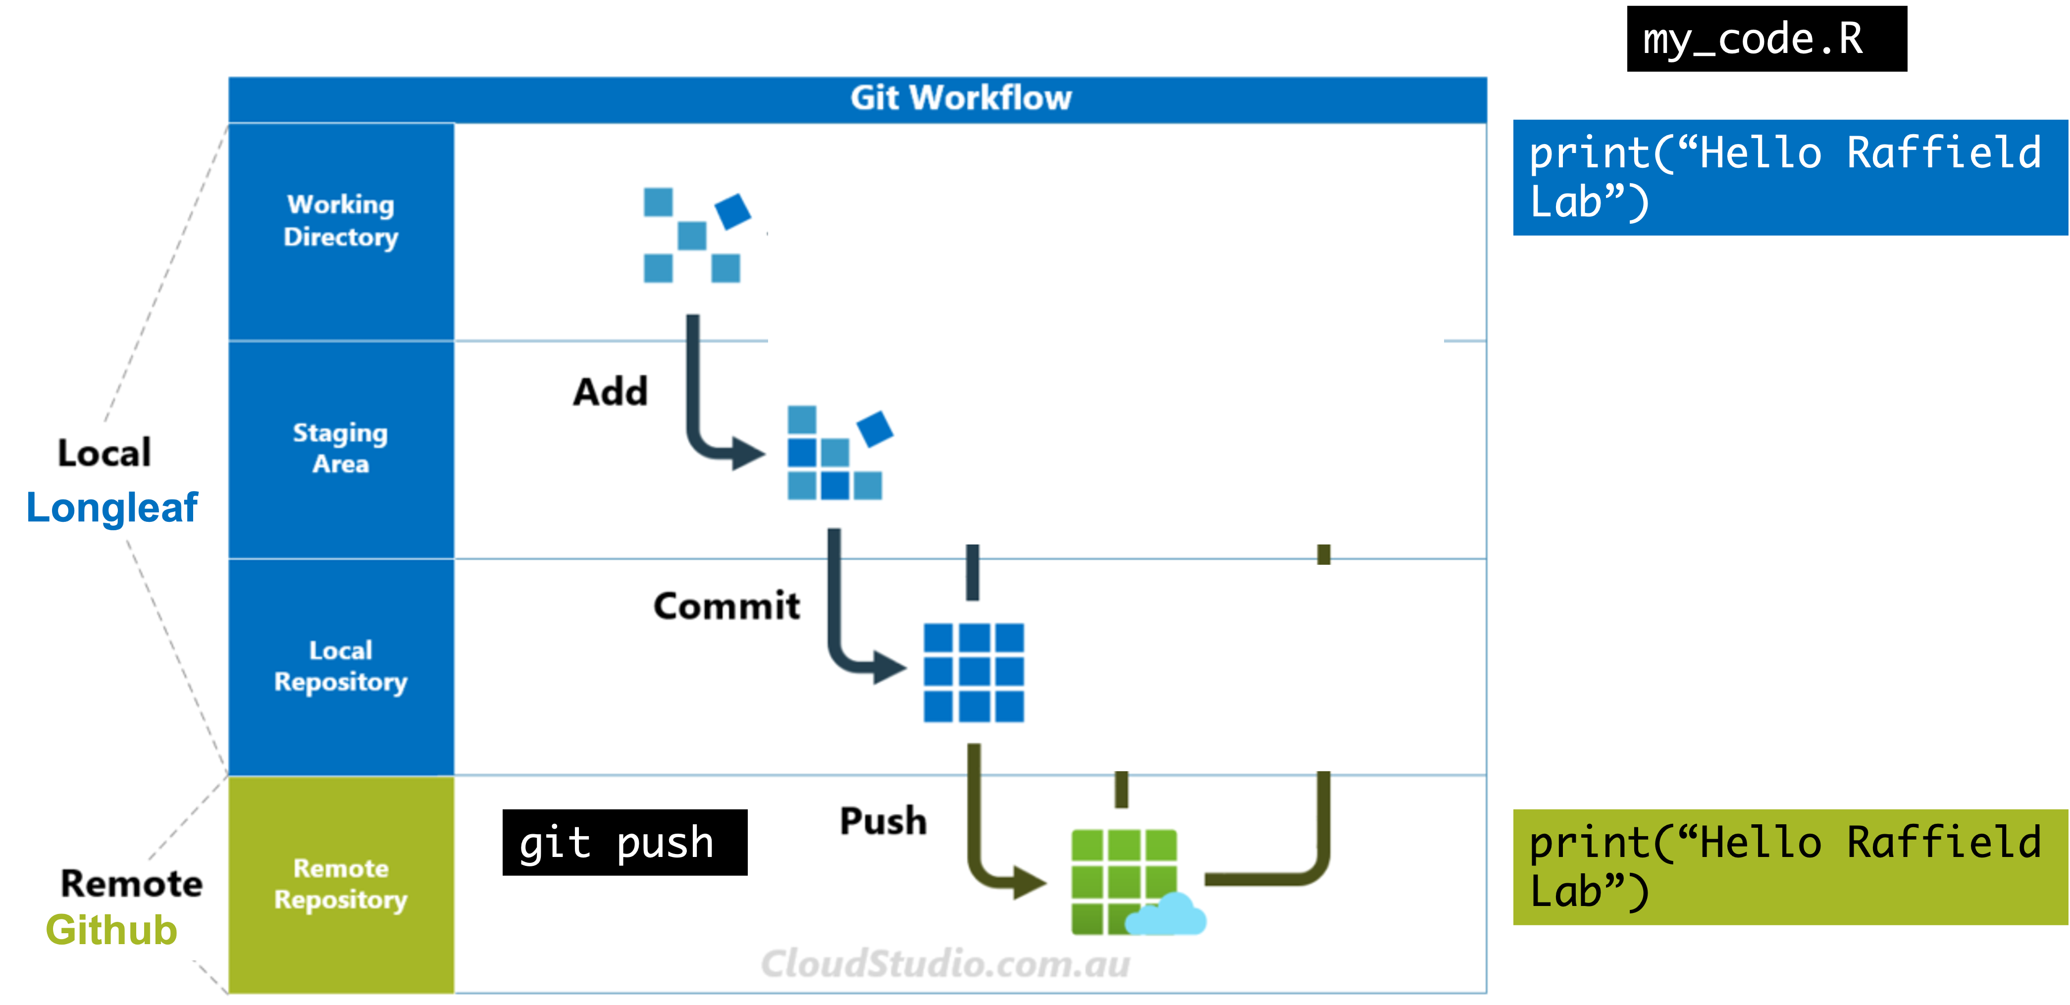
A basic git workflow - pushing a change

Slide 29
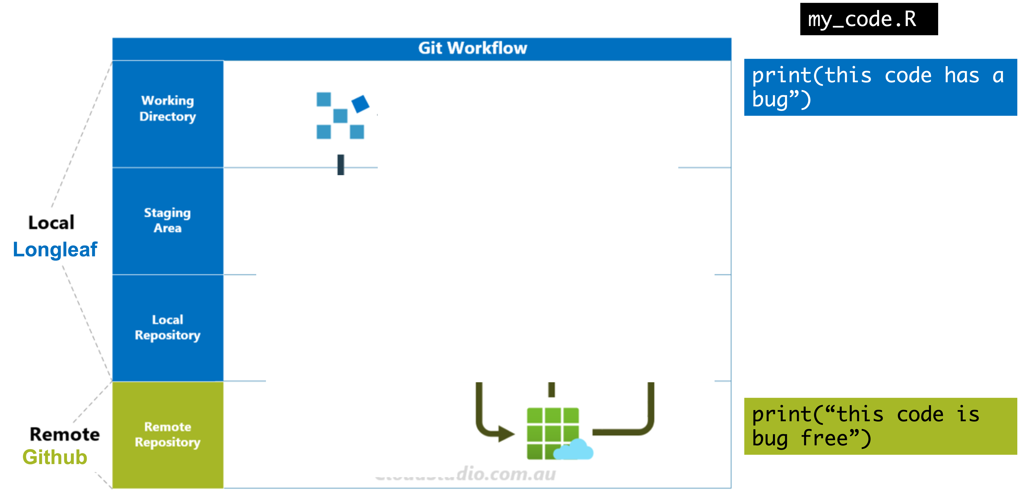
A basic git workflow - pulling

Slide 30
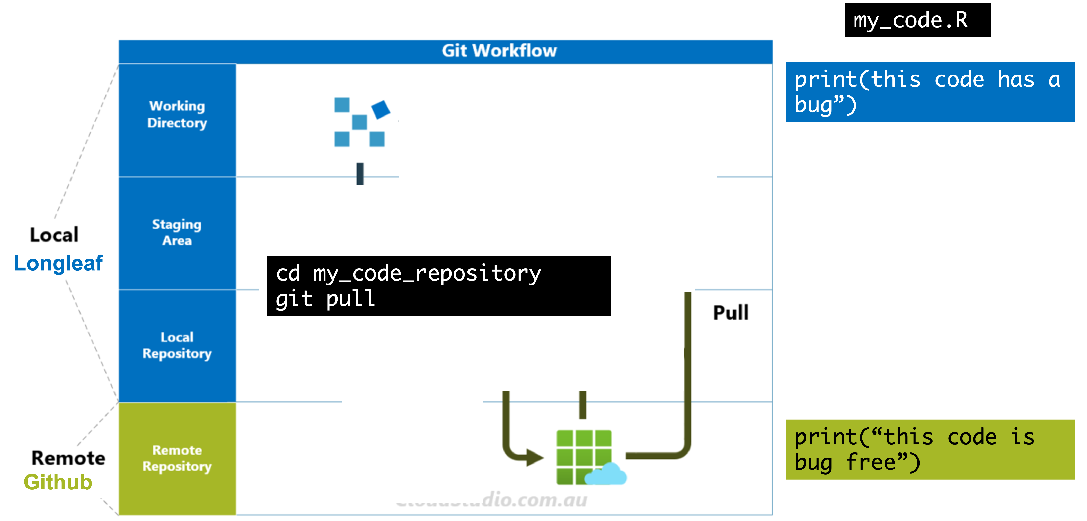
A basic git workflow - pulling

Slide 31
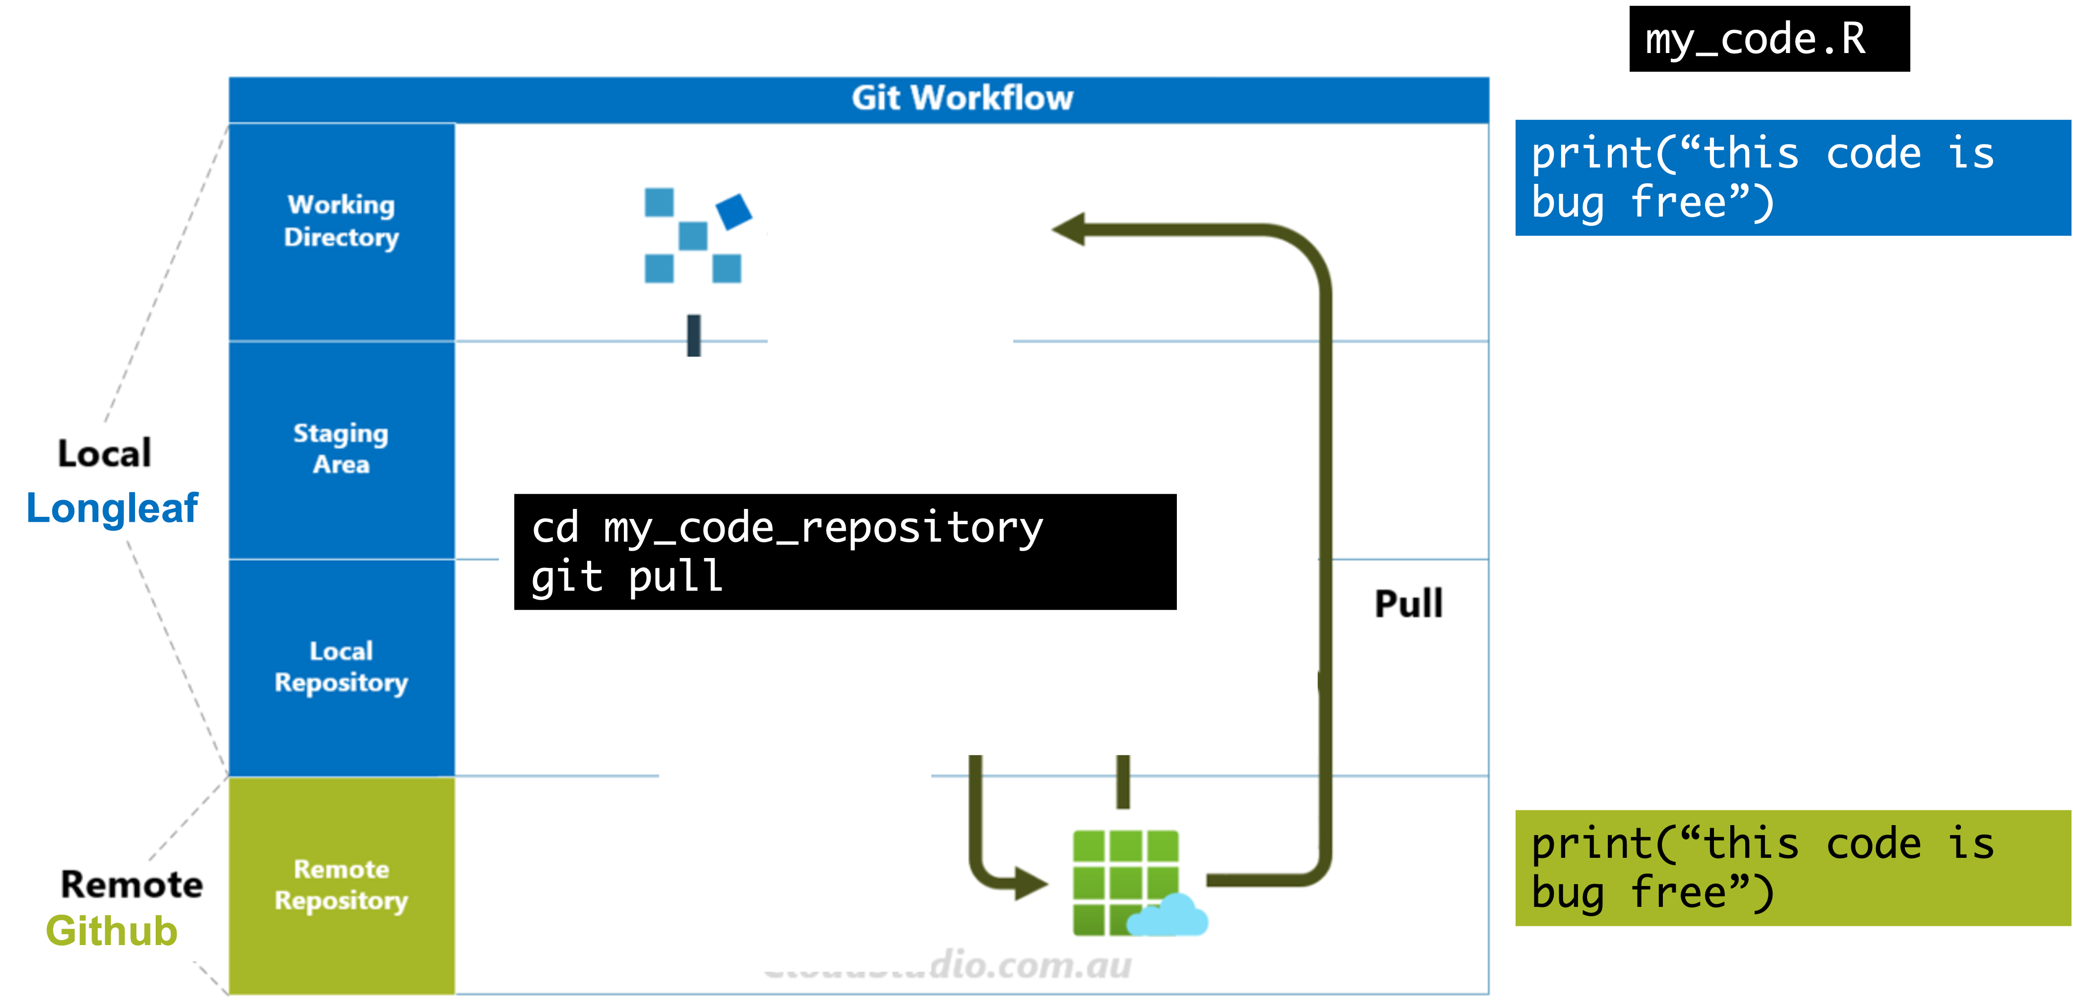
A basic git workflow - pulling

Slide 32
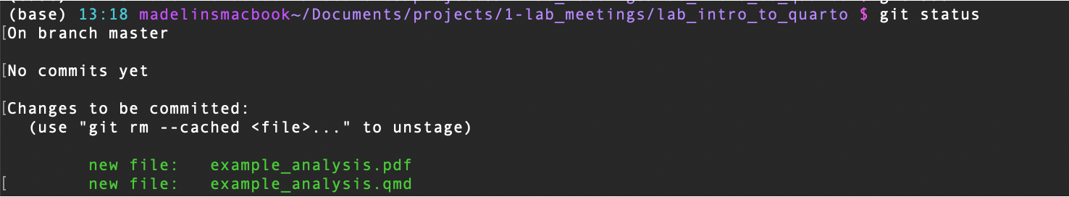
Other things to mention on git
Use git status in a repository at any point to see where things stand:
Which files have changes but not staged?
Which files are staged but not committed?
Which files have no changes?
What branch are you on?

Slide 33
Additional Resources
Quarto is not an R package, so “?” won’t get you help. Instead, refer to the Quarto documentation.
R for Data Science Quarto Chapter
Verify student status to get GitHub Pro free
Git/Github cheat sheet
Git tutorial for beginners
There are more advanced git uses you may need or run into. Look up:
Branches
Forking
Practice cloning this repository: https://github.com/madelinegillman/lab_intro_to_quarto

